Slide 1
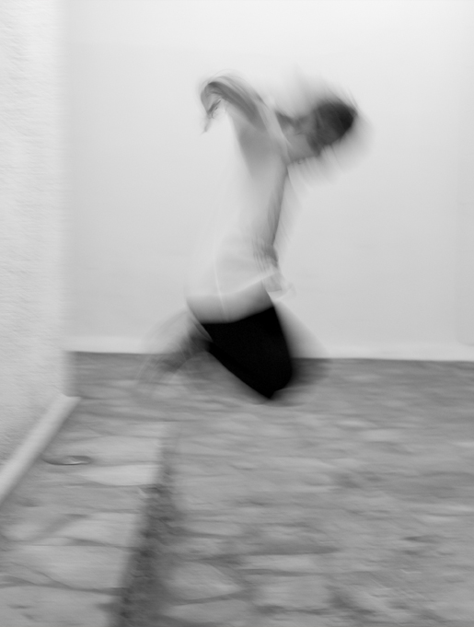
Locking Up Our Kids –
What Do We Hope to Achieve?
Mr Wayne Muir – Victorian Aboriginal Legal Service
****
Professor Nathan Hughes – Sheffield University
**** ****
Ms Anne Hooker – Port Phillip Prison
**** ****
Mr Roger Antochi – Talent RISE
****
Notes:
Image courtesy of Stefanos Papachristou, 2012, via Flickr (CC BY-NC 2.0)
URL: https://www.flickr.com/photos/spapax/7624749448

Slide 2
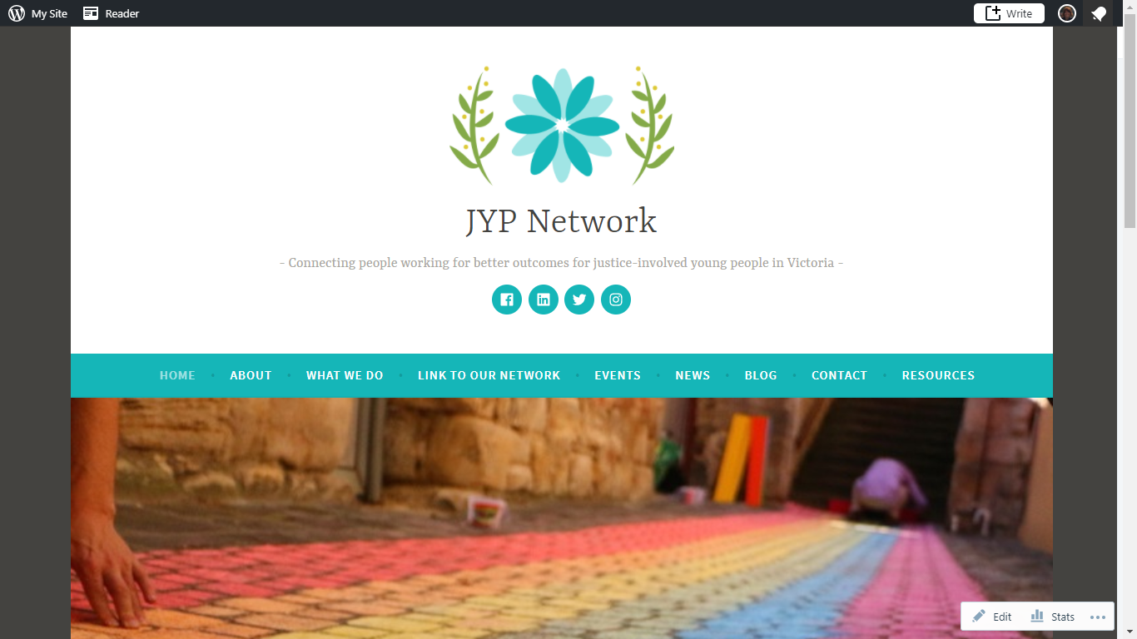

#LockingUpOurKids
@JYPnetwork
https://ypjustice.wordpress.com/
Notes:
https://ypjustice.wordpress.com/

Slide 3
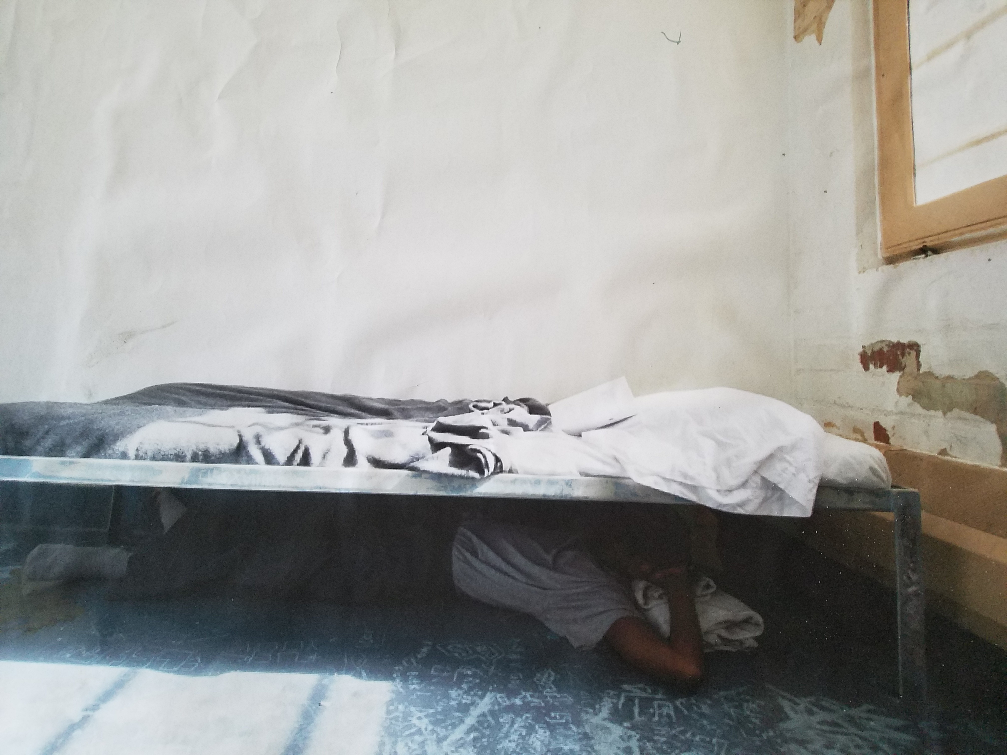
What do we hope to achieve?
Notes:
Image courtesy of Jon Mannion via Flickr (CC BY-NC-ND 2.0)
URL: https://www.flickr.com/photos/jmannion/38389131836/

Slide 4
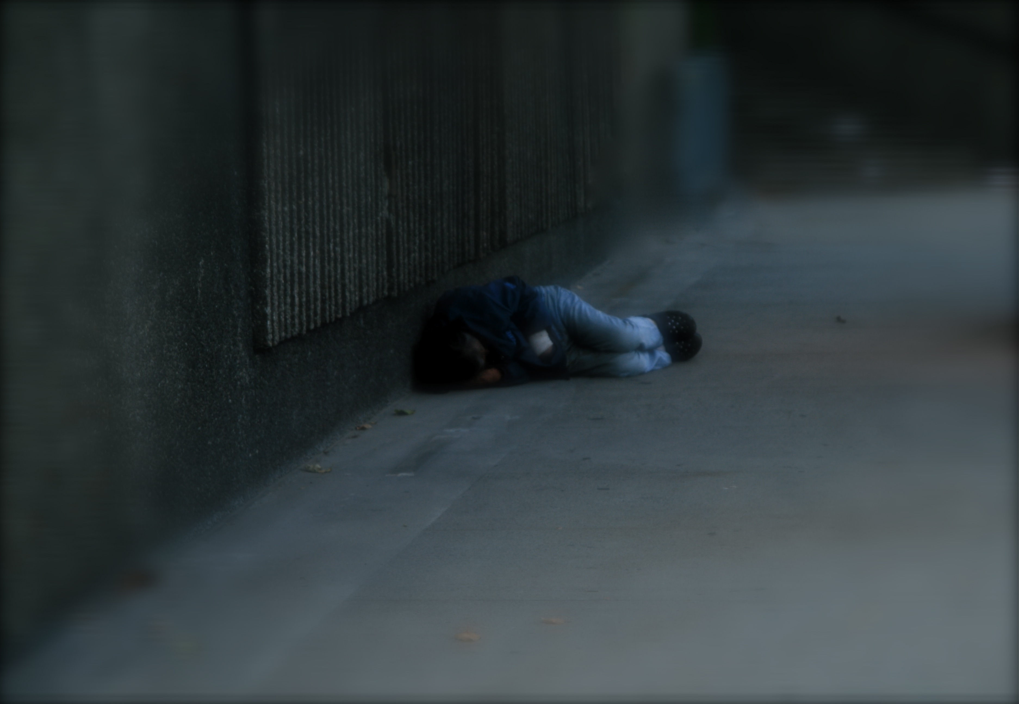
Who is locked up?
13% of children were homeless prior being locked up (Victorian Youth Parole Board 2017)
Notes:
Image courtesy of Noshin (Neelob) Baharabi via Flickr (CC BY-SA 2.0)
URL: https://www.flickr.com/photos/neelob/3907873422/

Slide 5
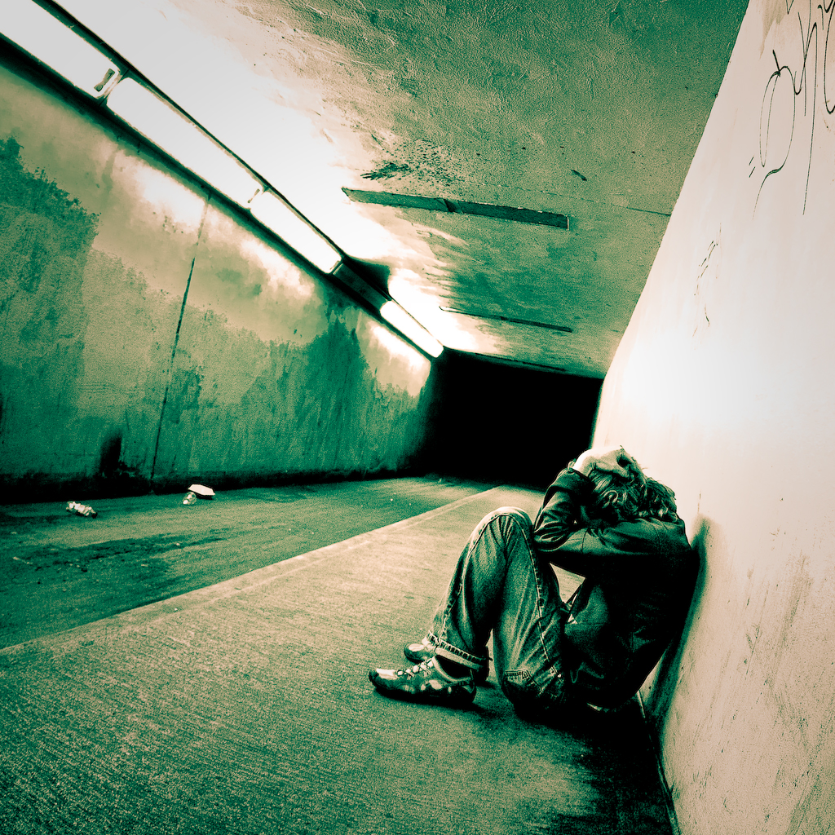
Child protection & youth justice
A ‘place for everyone to belong and not feel lonely or scared or anything like that...’
Recording of AH played to Royal Commission 30 June 2017
Voices: What children have told us – Child Protection (p.13)
Notes:
Image courtesy of Matthew, 2009, via Flickr (CC BY-NC-ND 2.0)
URL: https://www.flickr.com/photos/purplemattfish/3818663305/
Quote: Recording of AH played to Commission 30 June 2017
Voices: What children have told us – Child Protection (p.13)
Royal Commission into the Protection & Detention of Children in the Northern Territory

Slide 6
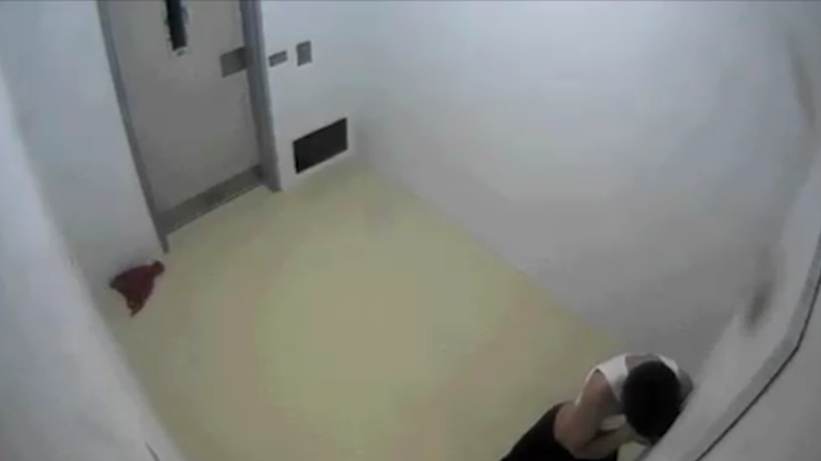
What are the harms?
Notes:
Image of Dylan Voller in 2011, age 14, in isolation at Don Dale Youth Detention Centre, NT, from ‘Australia’s Shame’, Four Corners, aired on ABC TV, 25 July 2016. Available: http://www.abc.net.au/4corners/australias-shame-promo/7649462

Slide 7
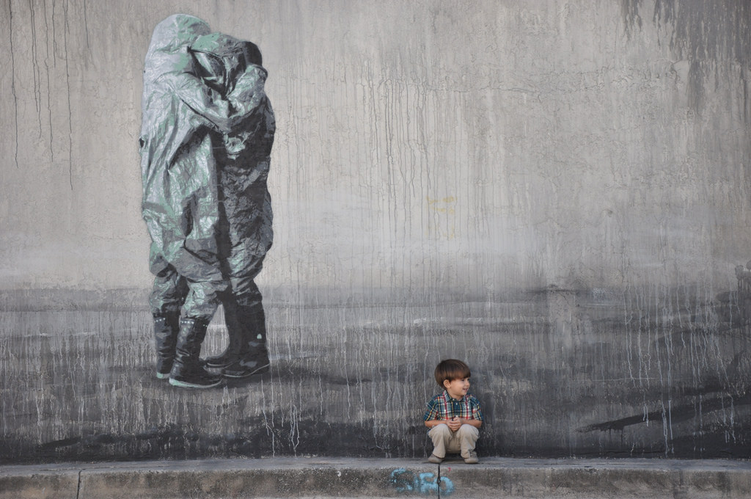
Criminal justice… or social justice?
Notes:
Image courtesy of Jose Carlos Zamora, 2011, via Flickr (CC BY-NC-ND 2.0)
URL: https://www.flickr.com/photos/59563208@N04/5448898880

Slide 8
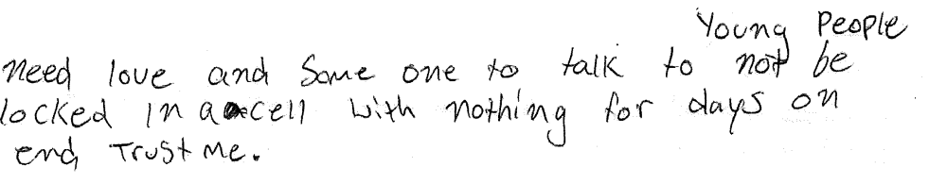
From Dylan Voller’s submission to the Royal Commission into the Protection and Detention of Children in the Northern Territory, December 2016
Notes:
Picture: AAP/Royal Commission Source: AAP via http://www.news.com.au/national/courts-law/dylan-voller-young-people-need-love-and-someone-to-talk-to-not-to-be-locked-in-a-cell/news-story/b391a3dd67181b8e1b8002b7f1bd0fc6

Slide 9
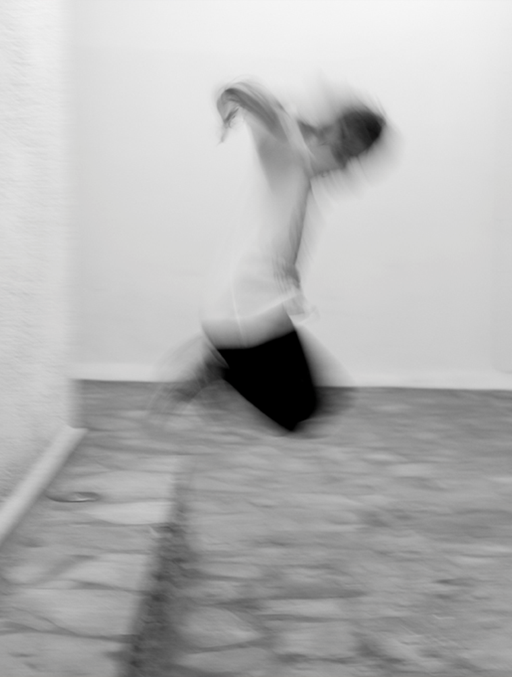
Time for your questions…
Notes:
Image courtesy of Stefanos Papachristou, 2012, via Flickr (CC BY-NC 2.0)
URL: https://www.flickr.com/photos/spapax/7624749448

